Slide 1
Example Data Sets for Python Function Development

Slide 2
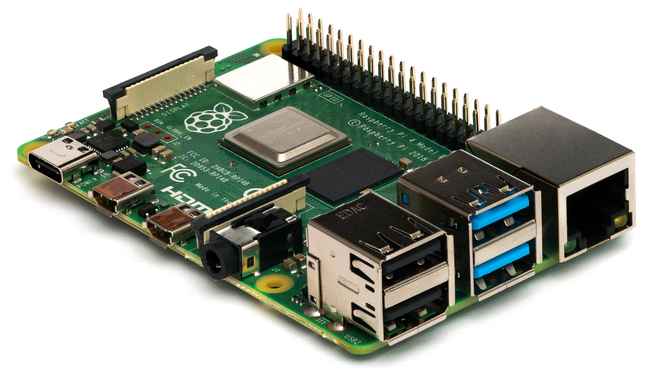

Axis Definition
Positive (+) axis orientation is chosen so that a positive reading
of Gravity (g) is seen if oriented towards bottom / earth center.
If resting on flat surface as shown in the pictures z-axis gives a reading of 1g.
+Pitch
+Y = Sway
+X= Surge
+Yaw
+Roll
+Z= Heave
Vector going into plane
Vector coming out of plane

Slide 3
(+) X-Axis Pointing into Gravity Vector Direction
gravity
Z= Heave
gr
Y = Sway
gravity
X= Surge
Y = Sway
X= Surge
Z= Heave

Slide 4
(+) Y-Axis Pointing into Gravity Vector Direction
gr
gravity
gravity
X= Surge
Z= Heave
X= Surge
Y = Sway
Z= Heave
Y = Sway

Slide 5
(+) Z-Axis Pointing into Gravity Vector Direction
Gravity
Going into plane
gr
gravity
X= Surge
X= Surge
Y = Sway
Z= Heave
Y = Sway

Slide 6
Example Data Sets Real Sensor Motion in Lab

Slide 7
Real Sensor Data
Resting Sensor, recorded data
RealSensorData_Restingdata.csv
Moving Sensor along a straight line (uncontrolled) for 33cm back and forth
RealSensorDatasLinearTranslation_33cm_data.csv
Moving sensor in rectangular of size 33cm x 27cm
RealSensorData_RectangularTranslation_33cmx27cm_Data.csv

Slide 8

Test NLZD.csv – moving along a line back and forth
33 cm
Gravity
Going into plane
gr
Gravity
Going into plane
Gravity
Going into plane
gr
gr
X= Surge
X= Surge
X= Surge
Gravity
Going into plane
gr
Gravity
Going into plane
Gravity
Going into plane
gr
gr
Compass direction from real compass.
Magnetometer reading
seems to have an offset or maybe I just interpret the data incorrectly.
Y = Sway
Y = Sway
Y = Sway
X= Surge
X= Surge
X= Surge
Accelerometer Data is in g
Gyroscope Data is in rad/seconds
Magnetometer Data is in uT
Y = Sway
Y = Sway
Y = Sway

Slide 9
NLZD.csv

Slide 10
Test NLZDR.csv – moving along a rectangular with heading change
33cm
Gravity
Going into plane
gr
Gravity
Going into plane
X= Surge
Y = Sway
gr
Y = Sway
X= Surge
gr
27cm
X= Surge
Compass direction from real compass.
Y = Sway
Y = Sway
Gravity
Going into plane
X= Surge
gr
Gravity
Going into plane
Accelerometer Data is in g
Gyroscope Data is in rad/seconds
Magnetometer Data is in uT

Slide 11
NLZDR.csv

Slide 12
Test NSZD.csv – moving along a rectangular
33cm
gr
gr
27cm
27cm
Y = Sway
Y = Sway
X= Surge
X= Surge
27cm
Gravity
Compass direction from real compass.
Z= Heave
Z= Heave
gr
gr
27cm
27cm
Y = Sway
Y = Sway
Accelerometer Data is in g
Gyroscope Data is in rad/seconds
Magnetometer Data is in uT
X= Surge
X= Surge
Gravity orthogonal to plane (aligned with -y axis / pointing opposite direction)
Z= Heave
Z= Heave

Slide 13
NSZD.csv

Slide 14
Test NSZR.csv & NSZR2.csv – moving along a rectangular with heading change
33cm
gr
27cm
Y = Sway
X= Surge
27cm
Gravity
Z= Heave
Compass direction from real compass.
Y = Sway
Z= Heave
gr
X= Surge
27cm
Accelerometer Data is in g
Gyroscope Data is in rad/seconds
Magnetometer Data is in uT
Gravity orthogonal to plane (aligned with -y axis / pointing opposite direction)

Slide 15
NSZR.csv

Slide 16
NSZR2.csv

Slide 17
Example Data Sets from Rigid Body Numerical Simulation

Slide 18
Motion Simulation Model
1003
Rigid Body Simulation performed
for structure shown left.
The boundary condition (prescribed motion has been applied to node 1000)
Results are reported for node 1000 and
1003.
z
1m
y
Available output:
Displacement x, y, z
Rotations rx, ry, rz
Velocities vx, vy, vz
Angular velocities vrx, vry, vrz
Acceleration ax, ay, az
Angular accelerations arx, ary, arz
x
1002
1m
1m
1000
1001

Slide 19
Set 1 – Square Path only Translation in X and Y Direction

Slide 20
Set 1 – Translation x and y – Square Path
y
x
10m
Start
10m

Slide 21
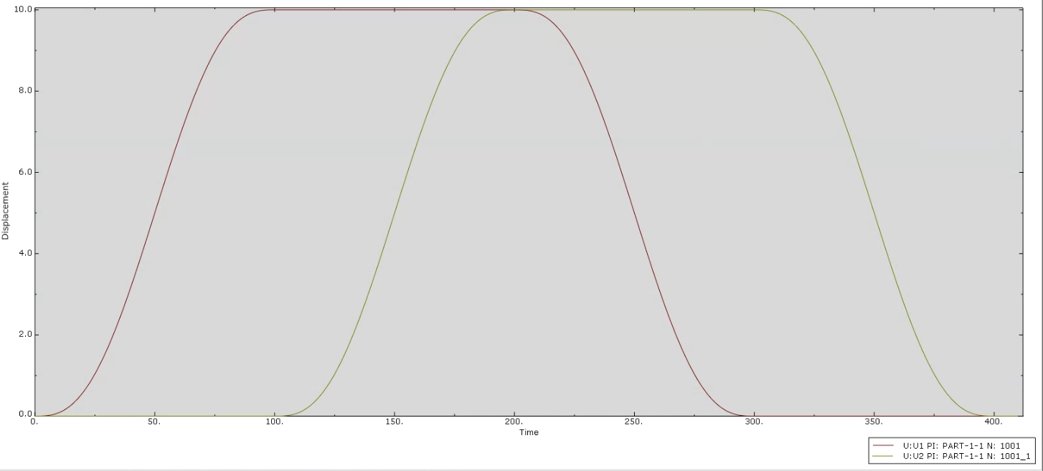
Set 1- Square Path, Displacement over Time Node 1001
Available output:
Displacement x, y, z
Rotations rx, ry, rz
Velocities vx, vy, vz
Angular velocities vrx, vry, vrz
Acceleration ax, ay, az
Angular accelerations arx, ary, arz
U1 = Displacement in X direction
U2 = Displacement in Y direction

Slide 22
Set 2 – Square Path Translation in X and Y Direction with Roll Motion

Slide 23
Set 2 – Square motion with Roll superimposed
y
x
10m
Periodic Roll (rotation around x axis) added to translation around square
Period 4s (1/4Hz)
Amplitude 2 degree
Start
10m

Slide 24
Set 3 – Square Path Translation in X and Y Direction with Pitch Motion

Slide 25
Set 3 – Square motion with Pitch superimposed
y
x
10m
Periodic Pitch (rotation around y axis) added to translation around square
Period 6s (1/6Hz)
Amplitude 3 degree
Start
10m

Slide 26
Set 4 – Square Path Translation in X and Y Direction with Roll and Pitch Motion

Slide 27
Set 4 – Square motion with Roll and Pitch superimposed
y
x
10m
Periodic Pitch (rotation around y axis) added to translation around square
Period 6s (1/6Hz)
Amplitude 3 degree
Periodic Roll (rotation around x axis) added to translation around square
Period 4s (1/4Hz)
Amplitude 2 degree
Start
10m

Slide 28
Set 5 – Square Path Translation in X and Y Direction with Roll, Pitch Motion and Heave

Slide 29
Set 5 – Square motion with Roll, Pitch and Heave superimposed
y
x
Periodic Pitch (rotation around y axis) added to translation around square
Period 6s (1/6Hz)
Amplitude 3 degree
10m
Periodic Roll (rotation around x axis) added to translation around square
Period 4s (1/4Hz)
Amplitude 2 degree
Periodic Heave (vertical translation) added to translation around square
Period 7s (1/7Hz)
Amplitude 0.2m
Start
10m

